Slide 1



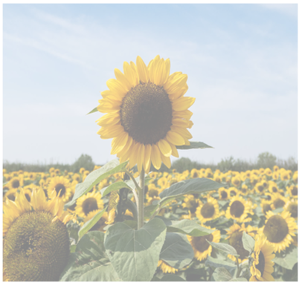
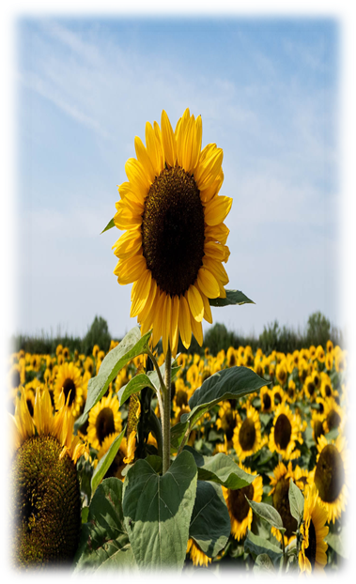












Touch to identify
Gallery
Name :- Sunflower
Scientific Name:- Helianthus
Location:- Ukraine is the world’s largest producer of the sunflower.
This is the Camara page of this application.
In camara page user can start flash light for more lighting, user can also close this page using cross button.
user can identify plant and get information about it.

